Slide 1
DAX

Slide 2
Topics
Introduction
Measure , Calculated Column
Types of DAX functions
DAX Concepts- Row context and Filter context

Slide 3
DAX
DAX is an acronym for Data Analysis Expression.
DAX is a library of functions and operators.
It can be used to build formulas and expressions to analyze the data.
DAX can be used in Power BI, Azure analysis service, SSAS Tabular model.

Slide 4
Purpose of DAX
Calculated columns
Calculated Measures
Calculated Tables – Date/ Calendar table

Slide 5
Calculated Column vs Measure
Calculated Column
Measure
Expands table by creating new column.
Stored in the data model. Hence consumes memory.
Less analytical capability- only simple calculations can be done.
In general, should be only used whenever created column is used as a slicer/filter.
Examples: Concatenation of first name and last name, Profit column when sales and cost column are available.
Summarizes data into a single value.
Computed at runtime. i.e. Dynamic. It changes as you change filters in the report.
Stored temporarily.
Rich analytical capability-
Examples:
Calculate, Rank, TopN

Slide 6
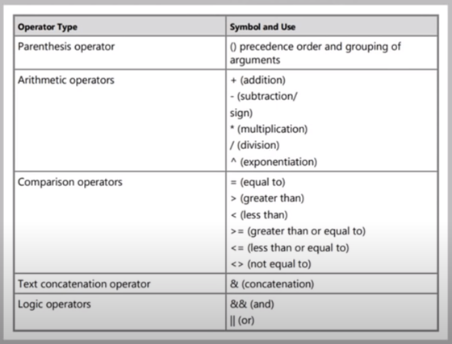
Operators

Slide 7
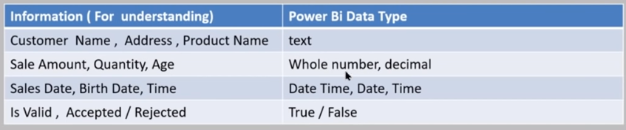
Data types

Slide 8
Row context
Row Context:
Evaluation of results takes place in each row with the help of values in that row.
Example:
Calculated column:
Full name=first name & last name
Measure:
SUMX(‘Sales,
sum(price)*sum(quantity)
)

Slide 9
Filter context
Evaluation of results occurs within the context of selected/applied filters.
Filters coming from Filter pane, Slicer and Visuals will be considered unless specified otherwise.

Slide 10
Calculate - Modified filter context
Evaluates an expression in a modified filter context.
Examples:
Total US Sales = Calculate(
SUM(Sales[Sales amount],
Region[Country]=“United States”
)
Total Country Sales = Calculate(
SUM(Sales[Sales amount],
ALL(Region[Country])
)

Slide 11
Types of DAX functions
Aggregation functions
Time intelligence functions
Filter functions
Logical functions
Statistical functions
Relationship functions
Text functions
Others

Slide 12
Functions with examples
Aggregation functions-SUM,SUMX,COUNT,COUNTROWS,COUNT
DISTINCTCOUNT.
Time intelligence functions-CALENDAR,TOTALYTD, DATEADD,DATESBETWEEN,SAMEPERIODLASTYEAR, YEAR,MONTH,QUARTER,TODAY,EOMONTH.
Filter functions- CALCULATE, ALL, ALLEXCEPT, REMOVEFILTERS,FILTER.
Relationship and Other functions- RELATED,RELATEDTABLE, ISBLANK, HASONEVALE,ISFILTERED,RANKX.

